Slide 1


模拟电子技术基础
Analog Device
1.2 Diode 二极管
Qingfeng Zhang 张青峰
Department of Electrical and Electronic Engineering

Slide 2
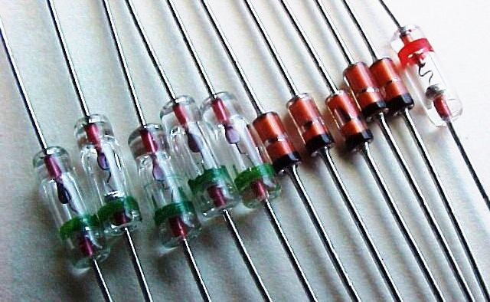
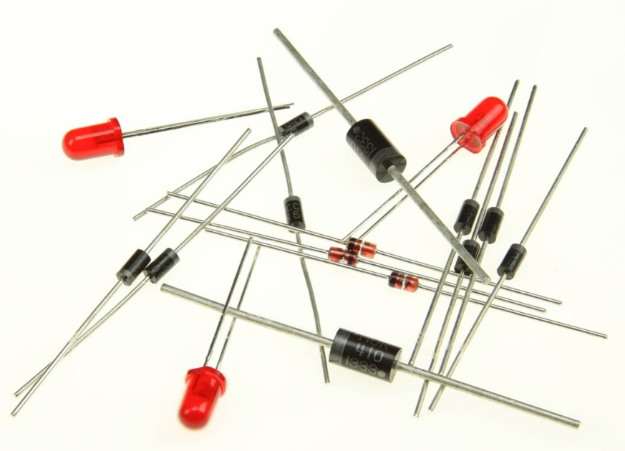
1.2 Diode 二极管
Diode: connect PN junction with wires and seal with shell.
P
N
Anode
Cathode
阳极
阴极

Slide 3
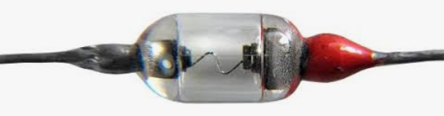
1.2.1 Types of diode
Point contact diode点接触型
Surface contact diode面接触型
Anode
Anode
Shell
PN junction
Al alloy
Cat whisker 触丝
N-type Si
Au-Sb Alloy金锑合金
N-type Ge
Base support底座
Cathode
Cathode

Slide 4
Planar diode平面型
Anode
SiO₂ protection layer
P-Si
N-Si
Cathode

Slide 5


1.2.2 Volt-ampere characteristics 伏安特性
P
N
Anode
u
Cathode
+
-
+
-
Anode
Cathode
P
N
u
+
-

Slide 6
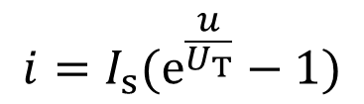
u
-
+
Anode
Cathode
P
N
i
Forward
I_{S}
u
击穿特性
Reverse Breakdown
Reverse
I_{S} : reverse current
U_{T} =KT/q: thermal voltage
T=300K, U_{T}=26 mV

Slide 7

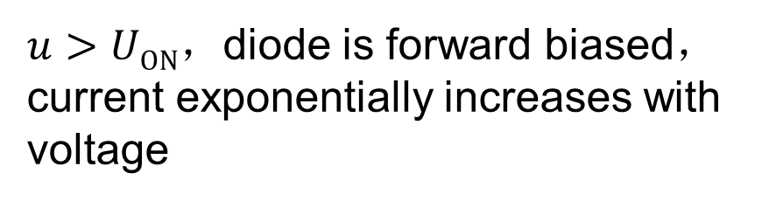




Forward characteristic
正向特性
Forward
死区
Reverse
Breakdown

Slide 8



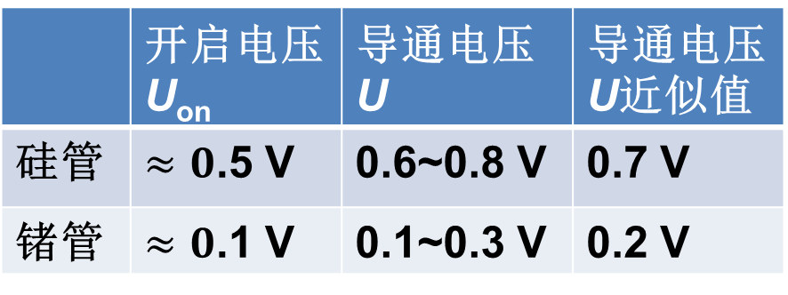
Forward characteristic
Diode | Threshold voltage U_{ON} | Working voltage U
Si |  | 0.6~0.8 V | 0.7 V
Ge |  | 0.1~0.3 V | 0.2 V
Forward
Reverse
Breakdown

Slide 9






Reverse characteristic
反向特性
Diode | I_{s}
Si | <0.1 μA
Ge | Order of 10 μA
Forward
Breakdown
Reverse

Slide 10





Reverse breakdown
|u|>|U_{BR}|，current increases dramatically and enter the reverse breakdown region.
Forward
If the reverse current is not too large, the diode can still work.
Breakdown
Reverse

Slide 11
Reverse breakdown
If the current is too large, the temperature of diode increases significantly, and diode breaks down permanently.
i
Diode | Breakdown temperature
Si | 150~200 ºC
Ge | 75~100 ºC
U_{BR}
I_{S}
u
Breakdown
Reverse
Breakdown mechanism：
Avalanche breakdown雪崩击穿
Zener breakdown齐纳击穿

Slide 12

Avalanche breakdown雪崩击穿
P
N
-
-
-
-
-
-
+
+
+
+
+
+
-
-
-
-
-
-
+
+
+
+
+
+
-
-
-
-
-
-
+
+
+
+
+
+
Internal electric field E
-
+
Minor carriers are accelerated to a very high speed and energy.
Accelerated electrons will collide with bonded electrons and kick them out.
More and more carriers are generated and current increases dramatically!

Slide 13
Avalanche breakdown雪崩击穿
P
N
-
-
-
-
-
-
+
+
+
+
+
+
-
-
-
-
-
-
+
+
+
+
+
+
-
-
-
-
-
-
+
+
+
+
+
+
Internal electric field E
-
+
The condition for observing the avalanche breakdown:
Depletion region is wide.
Low doping concentration.

Slide 14
雪崩击穿 Avalanche breakdown
半导体的掺杂浓度低
条件
耗尽层宽，击穿电压相对高
通过空间电荷区的电子和空穴，会在电场作用下，使获得的能量增大。在晶体中运行的电子和空穴将不断的与晶体原子发生碰撞，通过这样的碰撞可使束缚在共价键中的价电子碰撞出来，产生自由电子-空穴对。新产生的载流子在电场作用下撞出其他价电子，又产生新的自由电子和空穴对。如此连锁反应，使得阻挡层中的载流子的数量雪崩式地增加，流过PN结的电流就急剧增大击穿PN结，这种碰撞电离导致击穿称为雪崩击穿。
击穿电压高于6V
击穿的的特点
击穿电压具有正的温度系数

Slide 15

Zener breakdown 齐纳击穿
P
N
-
-
-
-
-
-
+
+
+
+
+
+
-
-
-
-
-
-
+
+
+
+
+
+
-
-
-
-
-
-
+
+
+
+
+
+
Internal electric field E
-
+
In highly doped PN junction, the depletion region is narrow.
When E is large enough, the bonded electrons can be directly pulled out by the strong electric field.
Large amount of free electrons are generated and current increases dramatically!

Slide 16
齐纳击穿 Zener breakdown
半导体的掺杂浓度高
条件
耗尽层窄，击穿电压相对低
当反向电压增大到一定程度时，空间电荷区内就会建立一个很强的电场。这个强电场能把价电子从共价键中拉出来，从而在空间电荷区产生大量电子-空穴对。这些电子-空穴对产生后，空穴被强电场驱到P区，电子被强电场驱到N区，使反向电流猛增。这种由于强电场的作用，直接产生大量电子-空穴对而使反向电流剧增的现象叫做齐纳击穿。
击穿电压低于4V
击穿的的特点
击穿电压具有负的温度系数

Slide 17
Temperature effect on the volt-ampere characteristics
i
Forward
Temperature ↑
Threshold voltage U_{ON} ↓
I_{S}
Reverse current I_{S} ↑
u
U_{ON}
Reverse

Slide 18



1.2.4 The model of diodes: forward
The symbol for ideal diode
Ideal diode
理想二极管
i
Real
+
-
Ideal
u

Slide 19



Constant-volt model 恒压模型
Q: The symbol?
i
Real
Ideal
U_{ON}
U_{ON}
u
+
-

Slide 20






Broken-line model 折线模型
Q: what’s the symbol?
i
Slope: G
U_{ON}
u
U_{ON}

Slide 21


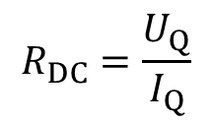

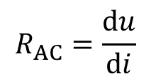
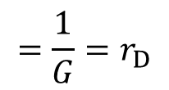
Question: what’s the DC and AC resistance at Q point?
u
i
DC signal
AC signal
Q
Slope: G
time
DC/static resistance: voltage/current signal is DC
U_{ON}
u
AC/dynamic resistance: voltage/current signal is AC

Slide 22

Broken-line model 折线模型
DC source
i
Slope: G
U_{ON}
U_{ON}
u
AC resistance

Slide 23

Small signal model
小信号模型、微变模型
This model is only for AC signal.
AC/dynamic resistance at Q point:
i
Δi
Q
Δu
u
Thermal voltage 热电压

Slide 24

Example:
U_{ON}=0.7V, r_{D}=200Ω
R=800Ω
U
[Q1] Using the broken-line mode, ask: when U= 0.5V, 1.7V, and -1.3V，the current in the circuit？
U_{ON}
r_{D}
R+r_{D}
R=800Ω
U-U_{ON}
U

Slide 25


i
R+r_{D}=1kΩ
U-U_{ON}
Ideal diode
u
1. U=-1.3V，U-U_{ON}=-2V，i=0;
2. U=0.5V，U-U_{ON}=-0.2V，i=0;
3. U=1.7V，U-U_{ON}=1V，i=(U-U_{ON})/(R+r_{D})=1mA;

Slide 26
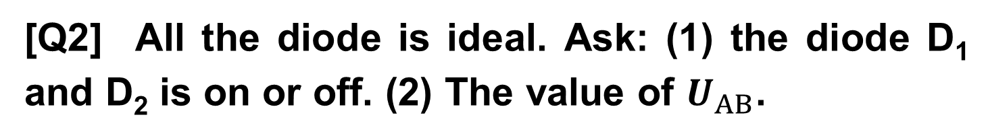
D₁
D₁
A
A
+
+
D₂
D₂
R
10 kW
R
10 kW
U_{AB}
U_{AB}
V₁
13 V
V₁
13 V
V₂
11 V
V₂
11 V
_
_
B
B
(a)
(b)

Slide 27
[Answer] How to judge diode on or off.
1. Assume diode is off, and analyze the circuit. If the u_{Diode}>U_{ON}, diode is on. If the u_{Diode}<U_{ON}, diode is off.
2. If there are two identical diodes D₁ and D₂ in the circuit，assume both diodes are off, and analyze the circuit. Compare u_{Diode1} with u_{Diode2}. The diode with higher u_{Diode} is on first. With one diode on, then judge the other diode.

Slide 28
[Answer] 判断电路中二极管工作状态的方法
1. 断开二极管，分析电路断开点的开路电压。如果该电压能使二极管正偏，且大于二极管的开启电压，二极管导通；否则二极管截止。
2. 如果电路中有两个二极管，利用方法1分别判断各个二极管两端的开路电压，开路电压高的二极管优先导通；当此二极管导通后，再根据电路的约束条件，判断另一个二极管的工作状态。

Slide 29
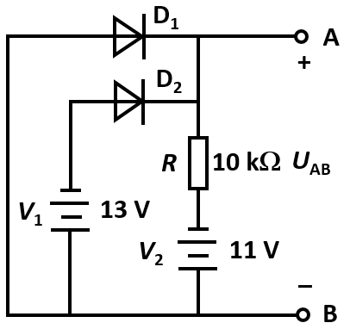
(a)
Fig.(a): voltage of D₁, D₂ is:
11 V，–2 V
D₁ on
D₂ off
Ｕ_{AB} = 0 V

Slide 30
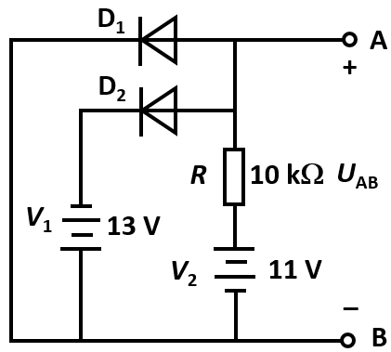
(b)
Fig.(b): voltage of D₁, D₂ is:
11 V，24 V
D₂ is on first
D₂ is on:
Ｕ_{AB} = –13 V
Voltage of D₁ is -13 V
D₁ off

Slide 31
[Q3] D₁ and D₂ are ideal, the input voltage u_{I} change from 0V to 30 V. Please draw the voltage transmission curve (u_{O} ~ u_{i}) 电压传输特性曲线.
i_{D1}
D₁
i_{D2}
D₂
+
i₁
i₂
+
R₁
5 kΩ
R₂
5 kΩ
u_{O}
u_{I}
V₁
6 V
V₂
18 V
_
_

Slide 32
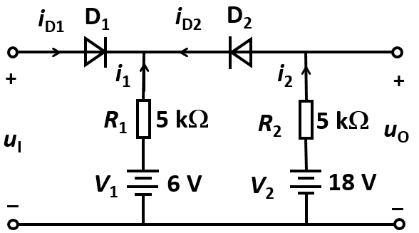
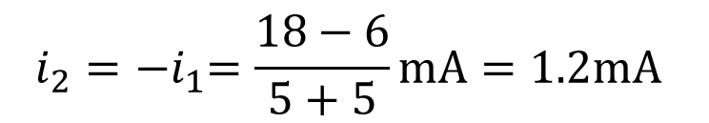





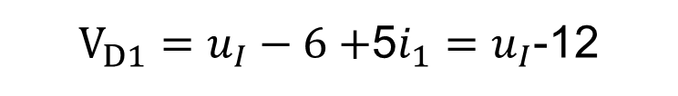

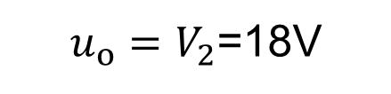
The first method
When u_{I}≤12 V，D₁ off, D₂ on:
[Ans] Assume D₁ and D₂ are off:
When 12 V<u_{I}<18 V，D₁, D₂ on
When u_{I}＜18 V，D₂ is on first
When 18 V ≤ u_{I}，D₁ is on first
When D₂ is on, voltage for D₁:
D₂ off

Slide 33
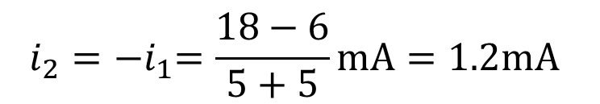

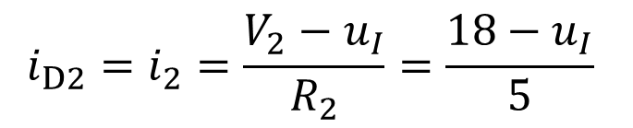

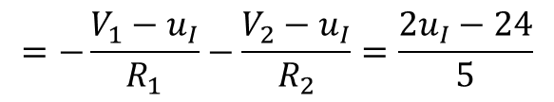

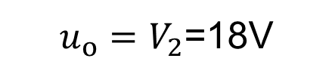
The second method
When u_{I}≤12 V，D₁ off, D₂ on:
[Ans] Assume D₁, D₂ are on:
When 12 V<u_{I}≤18 V, D₁ on, D₂ on
When 18 V<u_{I}， D₁ on, D₂ off
When D₁ is on: u_{I}＞12 V
When D₂ is on: u_{I}＜18 V

Slide 34
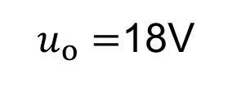


u_{O}~u_{I} curve
u_{O}/V
18
12
0
12
18
30
u_{I}/V

Slide 35
Application of diodes as rectifier
二极管在整流电路的应用
Input AC voltage signal:
u=Asin(ωt)
u
+
A
u
R
u_{out}
-
t
u_{out}
A
Output AC voltage signal:
Half-wave rectification
半波整流

Slide 36
Full-wave rectification全波整流
Input AC voltage signal:
u=Asin(ωt)
u
+
D4
D1
u
+
-
D2
t
D3
u_{out}
R
u_{out}
-

Slide 37
Full-wave rectification全波整流
Input AC voltage signal:
u=Asin(ωt)
u
-
D4
D1
u
+
+
D2
t
D3
u_{out}
R
u_{out}
-

Slide 38
1.2.5 Voltage regulator diode 稳压二极管
Working principle：
Forward
i
U_{Z}
I-V curve in breakdown region is very steep, which is almost parallel to y-axis.
u
Reverse
I_{z}
The reverse current change significantly, while the voltage is almost a constant. Hence it can stabilize the voltage.
Breakdown

Slide 39
Symbol of voltage regulator diode:
Forward
D_{Z}
i
Cathode
Anode
U_{Z}
u
Equivalent circuit
Reverse
I_{z}
D₁
Forward
Breakdown
Cathode
Anode
U_{Z0}
r_{Z}
D₂
Reverse

Slide 40
Forward
i
Key parameters:
U_{Z}
u
1. Working current I_{Z}：I_{zmax} > I_{Z} > I_{zmin}. Larger than I_{zmax}: device breakdown permanently. Smaller than I_{zmin}, the voltage stabilization effect becomes worse.
Reverse
I_{z}
Breakdown
2. Working voltage U_{Z}：almost a constant
3. Dynamic resistance r_{Z}: Smaller r_{z}, better performance
Cathode
Anode

Slide 41
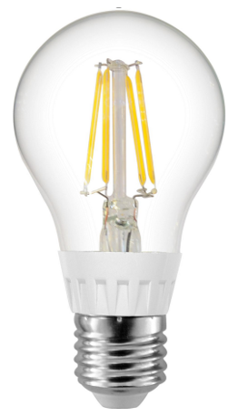
Working principle
+
R
Q: Input voltage U_{in} is unstable, and the bulb is flickering. How to resolve the problem？
U_{in}
_

Slide 42
R
I
I_{o}
+
R
+
+
I_{Z}
r_{Z}
U_{in}
U_{in}
D_{Z}
R_{L}
U_{out}
U_{Z}
_
_
_

Slide 43
R
I
I_{o}
+
+
I_{Z}
+
U_{in}
r_{Z}
D_{Z}
U_{Z}
R_{L}
U_{out}
_
_
_
R
I
I_{o}
U_{Z}= U_{Z0} + I_{Z}r_{Z}
+
+
I_{Z}
+
U_{Z0}
R_{L}
U_{out}
U_{in}
U_{Z}
r_{Z}
_
_
_

Slide 44


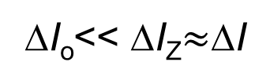





R
I
I_{o}
1st approach
+
I_{Z}
+
r_{Z}
U_{in}
D_{Z}
R_{L}
U_{out}
U_{Z}= U_{Z0} +I_{Z}r_{Z}
_
_
With regulator diode
ΔU_{out}=ΔI_{o} R_{L}
ΔI_{o}R_{L}<< ΔI R_{L}
Without regulator diode

Slide 45
R
I
I_{o}
2nd approach
+
I_{Z}
+
r_{Z}
U_{in}
D_{Z}
R_{L}
U_{out}
U_{Z}= U_{Z0} +I_{Z}r_{Z}
_
_
R_{L} ↑
U_{out} ↑
U_{Z} ↑
I_{Z} ↑↑↑
I ↑↑↑
Negative feedback!
U_{out}= U_{in}-IR ↓
I R ↑↑↑

Slide 46
R
I
I_{o}
+
+
I_{Z}
+
U_{in}
U_{Z}
D_{Z}
R_{L}
U_{out}
_
_
_
[Q4] The working voltage of regulator diode is U_{Z}，the maximum and minimum working current is I_{ZMAX} and I_{ZMIN}. Ask: the value of resistance R？

Slide 47
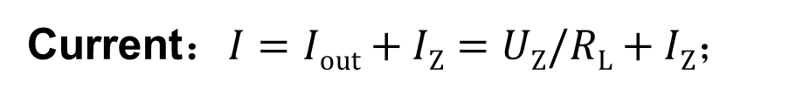

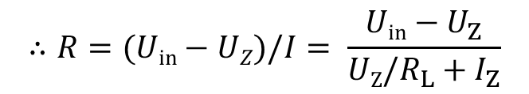

R
I
I_{o}
+
+
I_{Z}
+
U_{in}
U_{Z}
D_{Z}
R_{L}
U_{out}
_
_
_

Slide 48
Application in Wireless Communication
Modulated Signal
Signal Modulation
u₂
O
u₁
carrier
t
oscillator
modulator
u₂
transmitter
u₁
O
t
u
O
t
microphone
u
amplifier
Magnitude modulation
voice signal

Slide 49
Waveform Detection
u₁
u₂
u₃
O
O
O
t
t
t
D
R₂
C₂
+
+
+
amplifier
amplifier
L
C
u₁
u₂
R₁
C₁
u₃
–
–
–

Slide 50
Varactor (变容二极管)
Forward Biased: unbalanced minor carriers
1. PN Junction: Cap. Effect
(1) Diffusion Capacitance C_{D}
.
.
.
.
.
.
+
.
.
.
.
.
.
.
.
.
.
.
.
.
.
+
.
.
.
.
.
.
.
.
.
.
.
.
.
.
+
.
.
.
.
.
.
N
.
.
+
.
.
P
Major carriers in N zone diffusing to P zone become minor carriers, whose concentration decreases with distance.

Slide 51
.
.
.
.
.
.
+
.
.
.
.
.
.
.
.
.
.
.
.
.
.
+
.
.
.
.
.
.
.
.
.
.
.
.
.
.
+
.
.
.
.
.
.
N
.
.
+
.
.
P
3
3
ΔU>0
1
1
ΔU=0
Electron Concentration
2
2
ΔU<0
x

Slide 52
.
.
.
.
.
.
+
.
.
.
.
.
.
.
.
.
.
.
.
.
.
+
.
.
.
.
.
.
.
.
.
.
.
.
.
.
+
.
.
.
.
.
.
N
.
.
+
.
.
P
Electron concentration is proportional to biased voltage
Such an effect is presented by diffusion capacitance C_{D}

Slide 53
(2) Barrier Capacitance C_{B}
Space Charge Region
+
+
+
+
P
+
+
N
+
+
U

Slide 54
a. As the biased voltage increases
PN Junction gets narrower
Total charges decrease
+
+
P
+
N
+
U+ΔU (ΔU>0)

Slide 55
b. As the biased voltage decreases
Total charges increase
PN Junction gets wider
+
+
+
+
+
+
P
+
+
+
N
+
+
+
U-ΔU (ΔU>0)
Thus, the total charges change with the biased voltage
Such an effect is presented by barrier capacitance C_{B}

Slide 56
Summary
Junction Capacitance C_{j}
C_{j} = C_{D} + C_{B}
Reverse biased
Forward biased

Slide 57
Varactor: Symbol and C-U Curve
100
u_{D}
C
80
60
40
20
Symbol
0
2
4
6
8
10
12
C-U Curve

Slide 58
Homework: 1.1: 1.3, 1.4, 1.6

